Slide 1
London’s journey to Health and Care Devolution
London Councils Member Event
Will Tuckley, Chief Executive, LB Tower Hamlets, CELC Health Lead
February 1st 2018

Slide 2
The case for action
    London faces serious health challenges
    We’re not that healthy: only 7th out of 14 global cities; risk factors high; inequalities evident; children’s health concerns
    Demand for health services is growing: bigger population; ageing population
    Spending is rising and increasingly focused on acute services
    Change needed but:
    Aversion to top-down structural change
    Extraordinary public support – part of national identity
    Inability to generate consent for change

Slide 3
Case for Action
Local Government inextricably bound to NHS/health
    A critical issue for places
    Local/regional convenor – H&WBB, LHB
    Responsible for Public health/Population health
    Social care
Host of initiatives around integration, joint working and partnership
    All agree integration is required (‘around the patient’)
    At it for sometime – but partial and patchy

Slide 4
Attempts at solutions
  National/NHS version – STP’s?
  Some positive attributes – eg. recognition of place; health care as a system; commissioners and providers round the table
  But many negative ones; little on social care or prevention; patchy or no member involvement; rushed; drawn to short term
  Flawed – but we’ve found difficult to mobilise at this level
  Devolution – London /Manchester Agenda
  Principles – subsidiarity (different levels); bottom up solutions; pilots address complexity; menu for all; inclusive partnership model; early intervention; identify enablers for changes ( eg estates) ; built in democratic representation addressing question of consent
  Progress – grab the moment: lots of hard work, draft proposals in a year; asks and offers; five pilot business cases ; all levels; integration, prevention and estates; persuasion, joint working…and time!

Slide 5
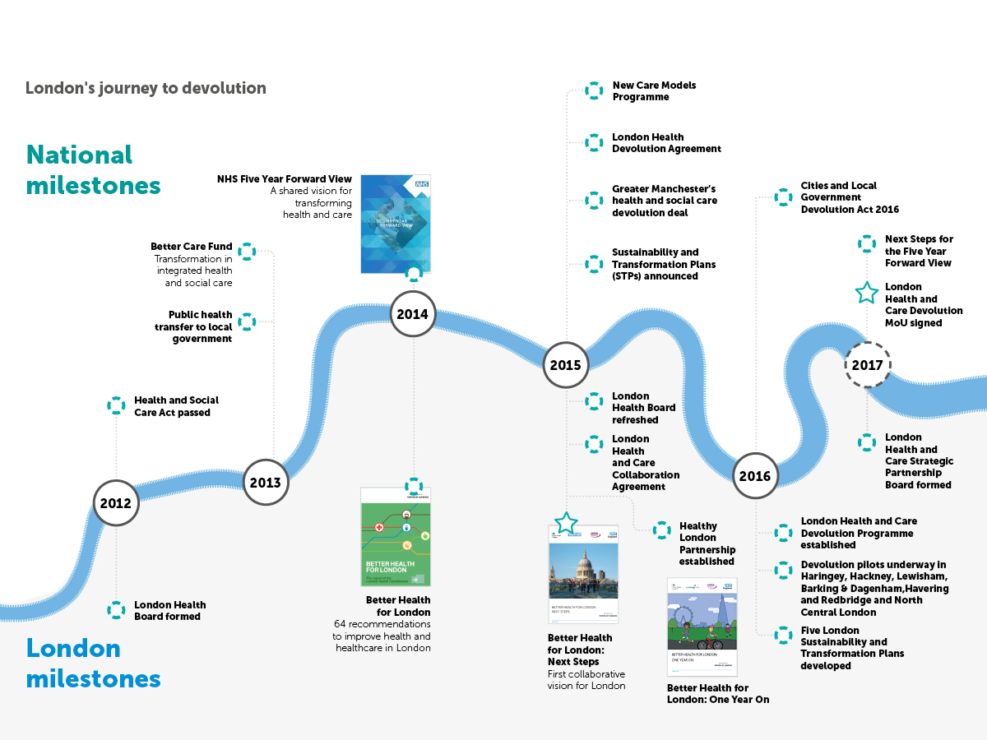
London’s journey to devolution
Notes:
Suggest Will Tuckley presents regarding the journey to devolution, with focus on Better Health for London, the 2015 devolution agreements, the devolution pilots and the 2017 MoU. Then Jane could perhaps cover looking to the future and the role of the Strategic Partnership Board.
We have always said that this isn’t about devolution for devolution’s sake. Our central purpose is to improve the health and wellbeing of Londoners. The devolution programme focused on prevention, integration and estates.
Our organising principles have been:
Enabling: pilots to go further and faster in delivering plans for bold and sustainable transformation
Co-developing: with local, London and national partners
Engaging: to understand the needs, blockers and develop the right solution
Subsidiarity: Making decisions as locally as possible, closer to the population
Sharing: To be open and transparent with emerging plans, information and learning. This has only just begun and to date has mainly focused on the work of the pilots. But this will need to accelerate now as we start to apply the enabling powers of devolution to support health and care transformation.

Slide 6
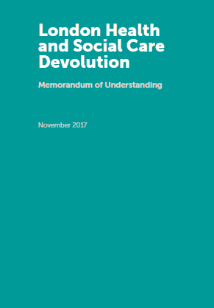
The Devolution MoU was signed on 16 Nov 2017
Notes:
The MoU is a testament to partnership and collaboration. Many of the signatures represent a number of different organisations – and over 100 are co-signatories to or referenced within the devolution MoU.
The MoU empowers health and care partners to use resources and organise and deliver services in a more tailored way. The MoU allows us to have more control over decisions to support prevention, health and care integration and use of and investment in NHS buildings.
The scale of the MoU is unprecedented in scope and extent of partnership – but the key will be in ensuring that we work better together in order to both ‘receive’ devolution powers and also to ensure that they are used to enable Londoners to be as healthy as possible for as long as possible, ensure that health and care services are proactive, joined up and high quality, and that we make the most of partnerships across the city that recognise that many of the critical contributors to health occur in schools, workplaces, homes and our streets.

Slide 7
Getting the governance right
Drivers for changing London’s governance:
Government wanted a robust governance structure to
  administer relevant decision-making
  provide both professional and political oversight
  oversee the transformation and sustainability of the health and care system
Required to
  build on established strategies such as the national NHS Five Year Forward View and Better Health for London
  recognise the importance of a partnership approach based around plans that are built up from local and sub-regional priorities, consistent with the principle of subsidiarity
  feed into the London Health Board which would provide political oversight.

Slide 8
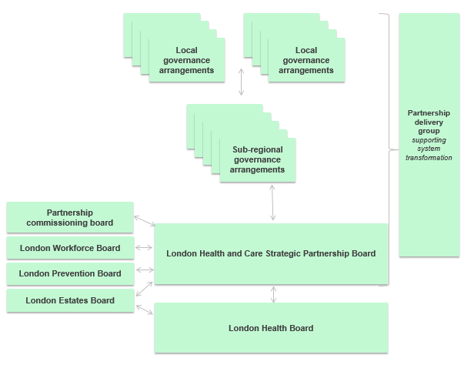
Devolution is not just about transfer of powers or functions it presents an opportunity to work in different and more integrated ways with the right governance structures in place
Notes:
The work of the pilots showed us that much of what we need to do can be done through existing powers and requires us to work better together. The MoU describes some specific ways in which we will do that. Our governance also provides a framework to ‘receive’ devolution.
A number of the speakers will be referring to collaborative delivery and governance arrangements, so to provide an overview and context [then refer to specific Boards at a high level]:
Key elements are:
Subsidiarity – we start from local arrangements and aggregate where needed. These local arrangements will be different based on local needs, appetite and ambition – this is entirely appropriate.
Collaboration – every one of the London-level arrangements is truly partnership based. Most of our Boards are co-chaired between health and care and have diverse representation from each of London’s STPs and wider partners.
Political oversight through the London Health Board, chaired by the Mayor.
We have spent a lot of the last year negotiating with national partners and starting to put in place some of the high-level governance to allow us to hit the ground running when the MoU was signed. But if this is to truly enable better health and care for Londoners, the ‘real’ work needs to be driven by you.
Today London partners and Devolution Pilots will highlight some of the key opportunities now available to us and we would welcome your input and feedback about how we can best work with you to help shape and refine the governance and delivery arrangements for London – and how the MoU could enable wider transformation underway within our health and care systems.

Slide 9
London Health and Care Strategic Partnership Board
A London Health and Care Strategic Partnership Board (‘SPB’) was first described within the devolution to do the following:
Enable a strategic view of challenges and opportunities across the city.
Support stronger collaboration between all health and care partners, which ensures that health and care strategy is built with the necessary clinical and public involvement
Ensure joint ownership of health and care strategy and reinforces local and sub-regional plans and priorities.
Provide operational oversight of London-level health and care governance structures and workstreams.
Enable learning to be shared and spread across the London system.
Receive devolved or delegated powers that may be appropriately exercised within a London level forum of this nature including transformation funding.
Membership: London Councils: including the CELC health lead as the Board Co-Chair, London CCGs, GLA, PHE, NHS England, NHS Improvement, Care Quality Commission, Health Education England, Third sector, clinical and patient groups

Slide 10
London Health Board
Political oversight would be provided through the London health board:
  The London Health Board (LHB) is a non-statutory group chaired by the Mayor of London comprising elected leaders and key London professional health leads.
  It was set up to provide political leadership to support health and care transformation at all spatial levels within London.
  LHB is composed of local government, NHS providers, NHS regional and CCG representatives
  The Board will have political oversight of London’s delivery of the devolution commitments.
Political representatives on the Board are:
  Cllr Kevin Davis, Leader, Royal Borough of Kingston upon Thames, and London Councils’ Portfolio Lead for Health
  Cllr Denise Hyland, Leader, Royal Borough of Greenwich, London Councils’ rep
  Cllr Richard Watts, Leader, London Borough of Islington, London Councils’ rep
Notes:
Political representatives on the Board are:
Cllr Kevin Davis, Leader, Royal Borough of Kingston upon Thames, and London Councils’ Portfolio Lead for Health
o Cllr Denise Hyland, Leader, Royal Borough of Greenwich, London Councils’ rep
o Cllr Richard Watts, Leader, London Borough of Islington, London Councils’ rep

Slide 11
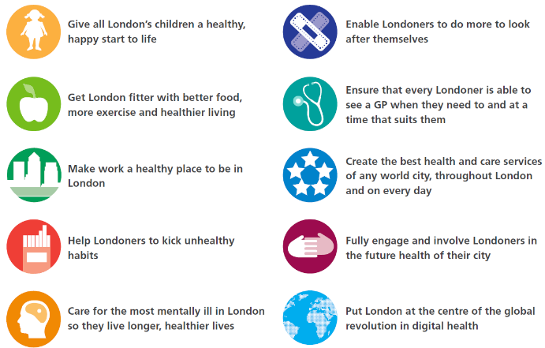
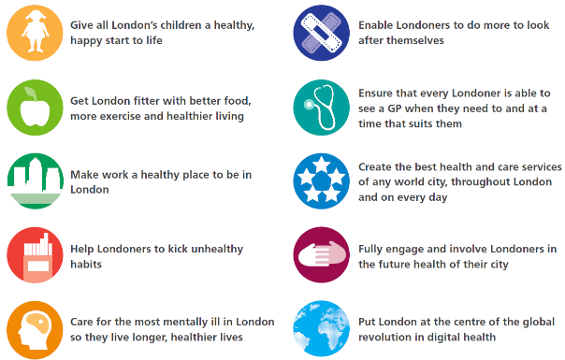





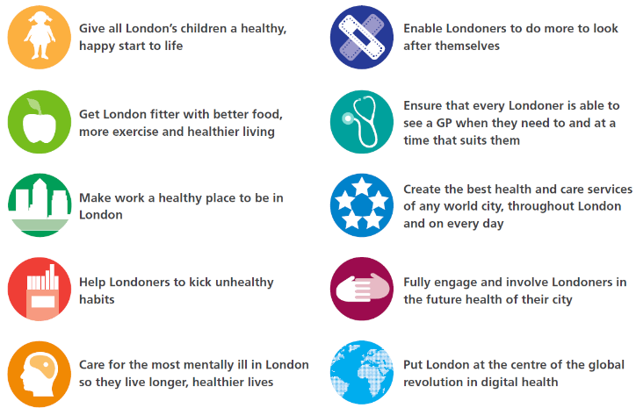
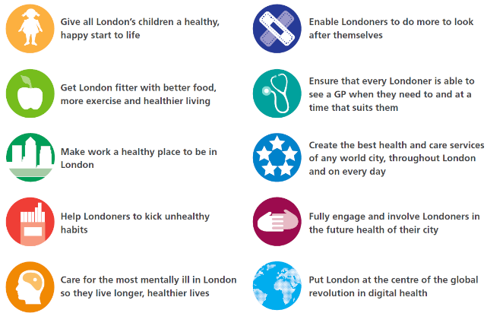

London aspires to be the world’s healthiest major global city
Give all London’s children a healthy, happy start to life
Get London fitter
Make work a healthy place to be in London
Help Londoners to kick unhealthy habits
Put London at the centre of the global revolution in digital health
Fully engage and involve Londoners in the future health of their city
Care for the most mentally ill in London so they live longer, healthier lives
Create the best health and care services of any world city, throughout London & on every day
Enable Londoners to do more to look after themselves
Ensure that every Londoner is able to see a GP when they need to and at a time that suits them
London is a place that enables health and wellbeing
Londoners shape their health and care services
Londoners are supported to manage their health and care
Londoners have more choice and availability of services, particularly in the community
Londoners experience unified health and care
Quality of health and care is high across London
London has a high quality and resilient health and care workforce
London’s Health and Care Devolution MoU marks a significant milestone to help meet the ambitions and aspirations set for the city
Notes:
Overarching vision
London aspires to be the healthiest major global city. But for this to become a reality, we need to work even better together, make the best use of all our assets – within health and care and beyond – and ensure that the diverse needs of Londoners are clearly understood and met.
London partners have set an overarching goal to make London the world’s healthiest major global city. The London Health Board published a shared vision of ten key aspirations to improve the lives of Londoners. These are ambitious goals and will take time – but as a city we are building strong foundations to deliver lasting improvements in health and care. London’s Health and Care Devolution MoU marks a significant milestone to help meet the ambitions and aspirations set for the city.
London is a place that enables health and wellbeing – our aspirations:
Wellbeing is at the heart of all services and is actively promoted throughout health and care.
Support is holistic, addressing the wider determinants of health and wellbeing.
Healthy choices are easy choices.
Londoners are supported to live longer, healthier and independent lives.
Londoners shape their health and care services
Londoners feel that they can contribute towards shaping their care system and are actively listened to.
Local politicians are part of local and regional health and care governance and decision-making
Londoners are supported to manage their health and care
Education and support empower Londoners to take better care of their own health.
Londoners are supported to manage long term conditions independently remaining in their homes and reducing dependency on formal services
Londoners have more choice and availability of services, particularly in the community
Londoners have control over the support they want that best meets their needs.
London’s services reflect and meet the needs of London’s diverse communities.
Care in the community becomes the norm.
Londoners’ best bed is their own bed.
Londoners are supported to die in their place of choice.
Londoners experience unified health and care
Londoners experience health and care as a joined up system with one access point.
Health and care staff work seamlessly, supported by better sharing of information across health and care and joined up commissioning
Quality of health and care is high across London
Care is standardised where needed to ensure high quality of care for every Londoner.
Londoners can rely on robust systems to support high quality and safe services. If things go wrong, the system works together to respond quickly.
London has a high quality and resilient health and care workforce
London has a workforce to meet Londoners’ health and care needs
London attracts the best talent.
Health and care careers are highly attractive to young Londoners.
Health and care workers can afford to live and work in London.

Slide 12
Thank You

