Slide 1

London Councils Workforce Profile
March 2022

Slide 2
Headlines
London Councils has 134 staff – 61% women and 39% men
Over the last 5 years – 2018 to 2022 - there has been an overall increase in black, Asian and minoritised ethnic staff from 31 (25%) in 2018 to 37 (28%) in 2022
The average pay gap is 8% in favour of men and 2% in favour of black, Asian and minoritised ethnic staff
Nine black, Asian & minoritised ethnic staff left during the last year (41% of leavers), but we only recruited six (24% of starters).
Average age in London Councils is 44 years. This compares to the London boroughs average of 46 years.
The number of staff with a disability in the workforce has increased to 5% from 3% last year.

Slide 3
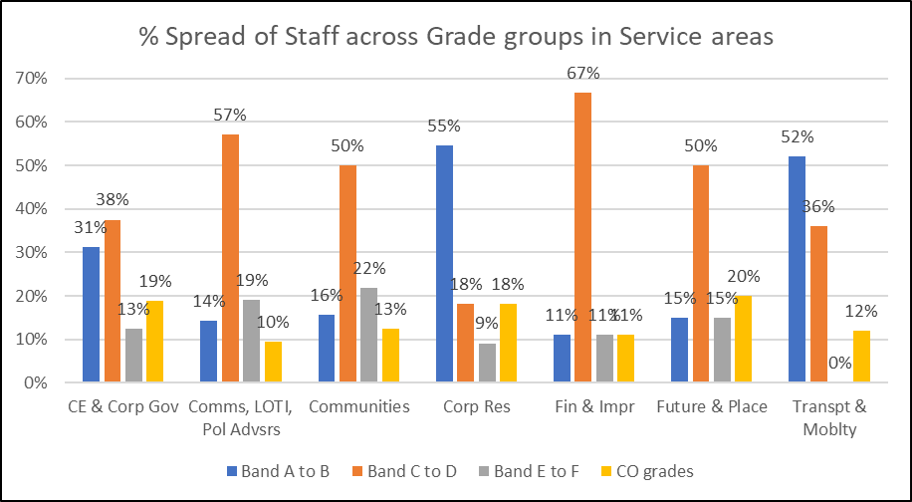
London Councils Workforce
Service Area | FTE | Headcount | % of LC
CE & Corp Gov | 15.1 | 16 | 12%
Comms, LOTI, Pol Advsrs | 21.0 | 21 | 16%
Communities | 29.8 | 32 | 24%
Corp Res | 10.7 | 11 | 8%
Fin & Impr | 8.7 | 9 | 7%
Future & Place | 19.0 | 20 | 15%
Transpt & Moblty | 23.0 | 25 | 19%
Grand Total | 127.3 | 134

Slide 4
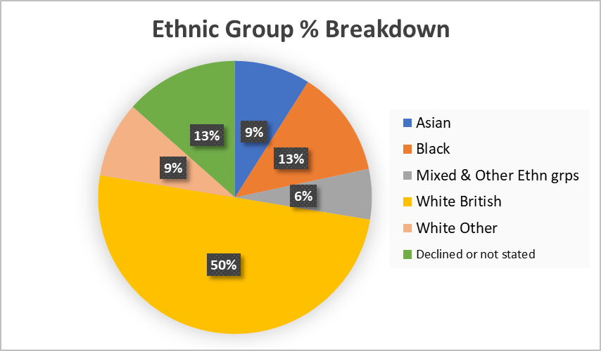
Ethnicity - % breakdown in a pie chart and table showing % of staff in Ethnic groupings within each Grade group
Ethnic Group | Band A to B | Band C to D | Band E to F | CO grades | Grand Total
Asian or Asian British | 11% | 10% | 11% | 0% | 9%
Black or Black British | 14% | 16% | 6% | 5% | 13%
Mixed & Other Ethnic grps | 0% | 2% | 22% | 16% | 6%
White British | 44% | 56% | 39% | 53% | 50%
White Other | 11% | 7% | 11% | 11% | 9%
Declined or Not stated | 19% | 10% | 11% | 16% | 13%
Grand Total | 36 | 61 | 18 | 19 | 134
% | 27% | 46% | 13% | 14% | 100%

Slide 5
Black, Asian and minoritised ethnic groups over time and Intersectionality information
We have compared information between 2018 and 2022 to understand progress
There has been an overall increase in black, Asian and minoritised ethnic staff from 31 (25%) in 2018 to 37 (28%) in 2022
There has been an increase in 5 female Asian staff (an increase of 100%) spread across pay bands B to E. There has also been an increase of 2 male black, Asian and minoritised ethnic staff in pay band E (a 20% increase).
There is an overall increase in black, Asian and minoritised ethnic group females across most age groups but mostly in the 51-60 age group – from 9 to 12 staff. Male black, Asian and minoritised ethnic staff have also seen an increase in the 51-60 age group – from 2 to 6 staff.
Outlined below is a slide showing progression of female and male Black, Asian and Minoritised Ethnic staff in grade groups over the last 5 years 2018 to 2022.
The general trend is positive but the graphs show fluctuating progress over time.

Slide 6
Progression of female and male Black, Asian and Minoritised Ethnic staff in grade groups over the last 5 years 2018 to 2022 – The graphs show a general positive trend in representation but fluctuating progress over time

Slide 7
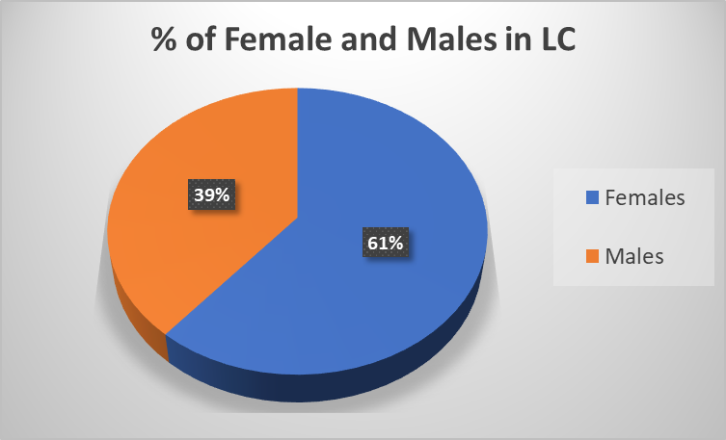
Gender - % breakdown by grades and service groups
Grade Group | Females | Female % | Male | Males % | Total
Band A to B | 26 | 72% | 10 | 28% | 36
Band C to D | 39 | 64% | 22 | 36% | 61
Band E to F | 8 | 44% | 10 | 56% | 18
CO grades | 9 | 47% | 10 | 53% | 19
Grand Total | 82 | 61% | 52 | 39% | 134
The percentage and number of Female staff has increased since 2019 from 53% to 61% and 82 staff
Service Groups | Females | Female % | Male | Males % | Total
CE & Corp Gov | 10 | 63% | 6 | 38% | 16
Comms, LOTI, Pol Advsrs | 14 | 67% | 7 | 33% | 21
Communities | 23 | 72% | 9 | 28% | 32
Corp Res | 5 | 45% | 6 | 55% | 11
Fin & Impr | 4 | 44% | 5 | 56% | 9
Future & Place | 10 | 50% | 10 | 50% | 20
Transpt & Moblty | 16 | 64% | 9 | 36% | 25
Grand Total | 82 | 61% | 52 | 39% | 134

Slide 8
Gender and Ethnicity Pay Gaps
 | Women | Men
Mean Pay Gap |  | 7.9% for Men
Median Pay Gap |  | 10.9% for Men
Lower Pay Qtr | 70% | 30%
Middle Pay Qtr | 64% | 36%
Upper Middle Pay Qtr | 61% | 39%
Upper Pay Qtr | 48% | 52%
 | BAME | White
Mean Pay Gap | 1.8% for BAME
Median Pay Gap | Nil | Nil
Lower Pay Qtr | 24% | 58%
Middle Pay Qtr | 27% | 64%
Upper Middle Pay Qtr | 33% | 58%
Upper Pay Qtr | 28% | 56%
The reason for difference in pay is most likely because there is an uneven distribution across pay grades/ levels
In London Councils the pay quartiles roughly equate to the following pay scales
Upper pay quartile – Grades E and above
Upper middle – Grade D
Middle – Grade C
Lower pay quartile – Grades A and B

Slide 9
Pay Gap comparison information - note comparison year is 2021 (last year)
Last year 2021 – Gender pay gap | Workforce % women | Workforce % men | Mean Pay Gap | Median pay gap
London Councils – 131 staff | 56% | 44% | 14.6% for men | Nil 0% difference
LGA – 402 staff | 63% | 37% | 14.4% for men | 25.8% for men
GLA – 1128 staff | 60% | 40% | 4.9% for men | 2.1% for men
London boroughs Average of 33 LBs | 62% | 38% | 2.6% for men | 0.7% for men
Last year 2021 – Ethnicity Pay Gap | Workforce % BAME | Workforce % White | Mean Pay Gap | Median pay gap
London Councils – 131 staff | 31% | 57% | 6.6% for white staff | 0.5% for BAME staff
GLA – 1128 staff | 31% | 64% | 13.7% for white staff | 11.1% for white staff

Slide 10
Turnover and Recruitment
There were 22 leavers and 25 new starters in the last year.
Nine leavers were women (41%) but we recruited eighteen women (72%).
Nine (41% of leavers) black, Asian & minoritised ethnic staff left, but we only recruited six (24% of starters).
We did some analysis of recruitment on the BeApplied anonymous recruitment system.
143 applicants for 10 roles:
• 46% applicants were women, 61% women were shortlisted and we’ve recruited 72% women;
• 48% applicants were from black, Asian, minoritised ethnic backgrounds (BAME), 41% BAME were shortlisted and 24% BAME recruited overall;
• 7% applicants were disabled and we recruited 4 disabled staff 16% of starters.
Grade Group | Headcount | Leavers | % Turnover
Band A to B | 36 | 6 | 16%
Band C to D | 61 | 11 | 18%
Band E to F | 18 | 1 | 7%
CO grades | 19 | 4 | 21%
Grand Total | 134 | 22 | 17%
Last year turnover was at 17%, the year before was 14%.
Turnover for female staff was 11% and male staff was 24%

Slide 11
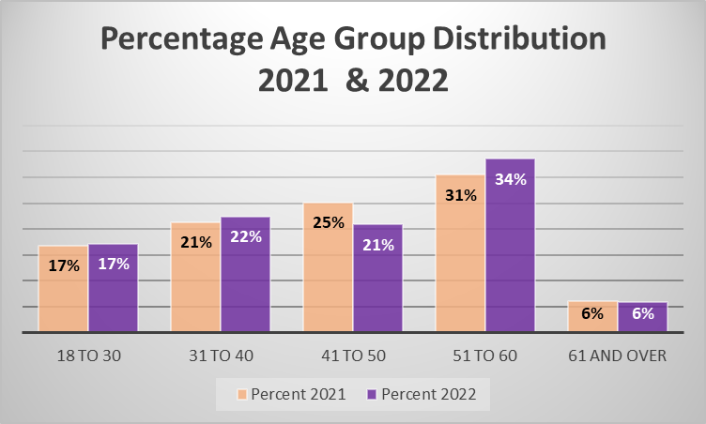
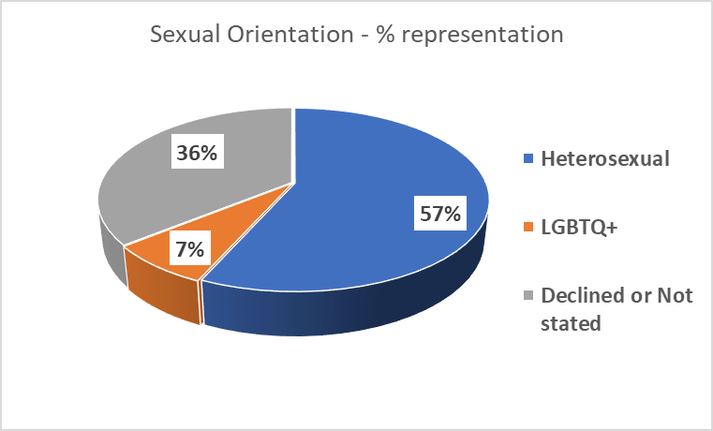
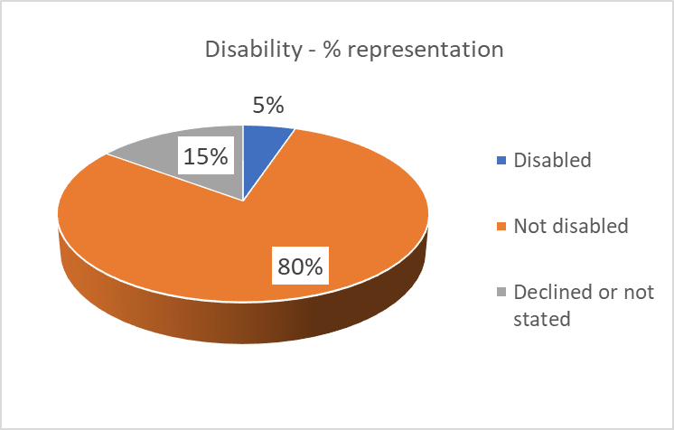
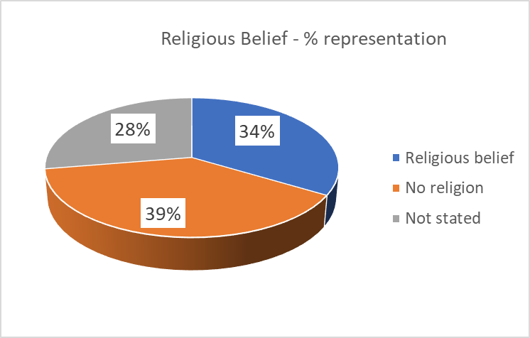
Age, Disability, Sexuality, Belief

