Slide 1
Workforce SLI workshop
ALCDS Sector Led Improvement
DfE Children’s Social work workforce 2018

Slide 2
London Workforce Numbers
4850 FTE Social Children's and Families Social Workers in London in 2018
9.7% Increase from 2014 to 2018

Slide 3
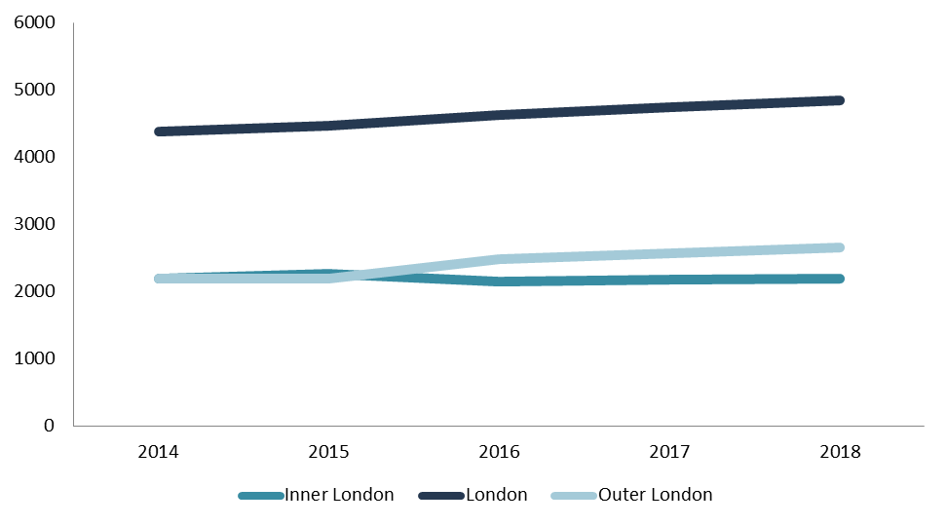
FTE Workforce Numbers
Outer London has seen an increase in workforce year on since 2015 whilst Inner London observed a decline from 2015 to 2016 but has remained stable in numbers since

Slide 4
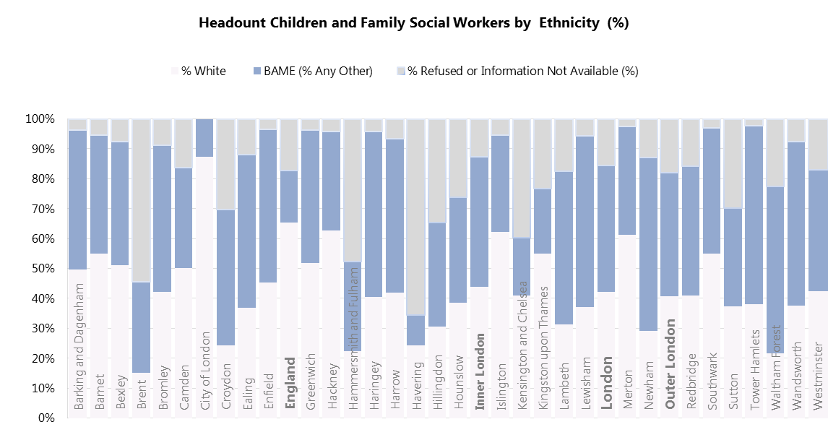
FTE Workforce Numbers

Slide 5
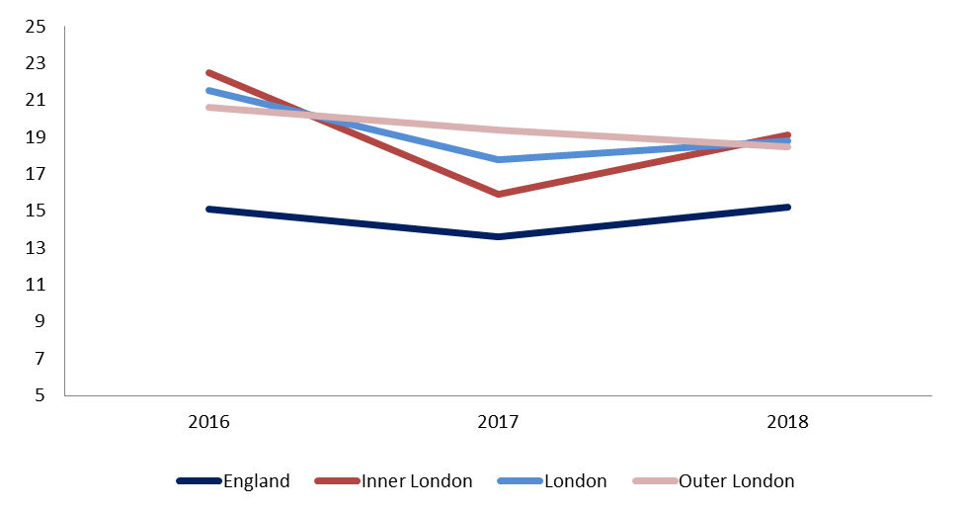
Turnover Rates (2018) Year on Year
England: 15.2%
London: 18.8%
Inner London 19.1%
Outer London 18.5%
Inner London saw a -7% point decline 2016 to 2017, and increased back up to previous levels. Less variance for Outer London

Slide 6
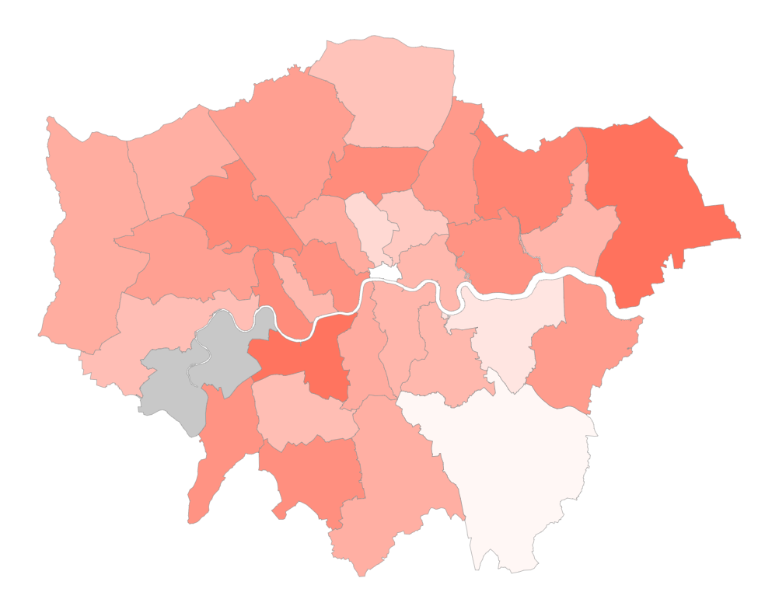
Turnover Rates
Turnover Rates
The Turnover rate fluctuates across London.
Havering had the highest Turnover rate of 32.2%, and City of London the lowest 1.9%

Slide 7
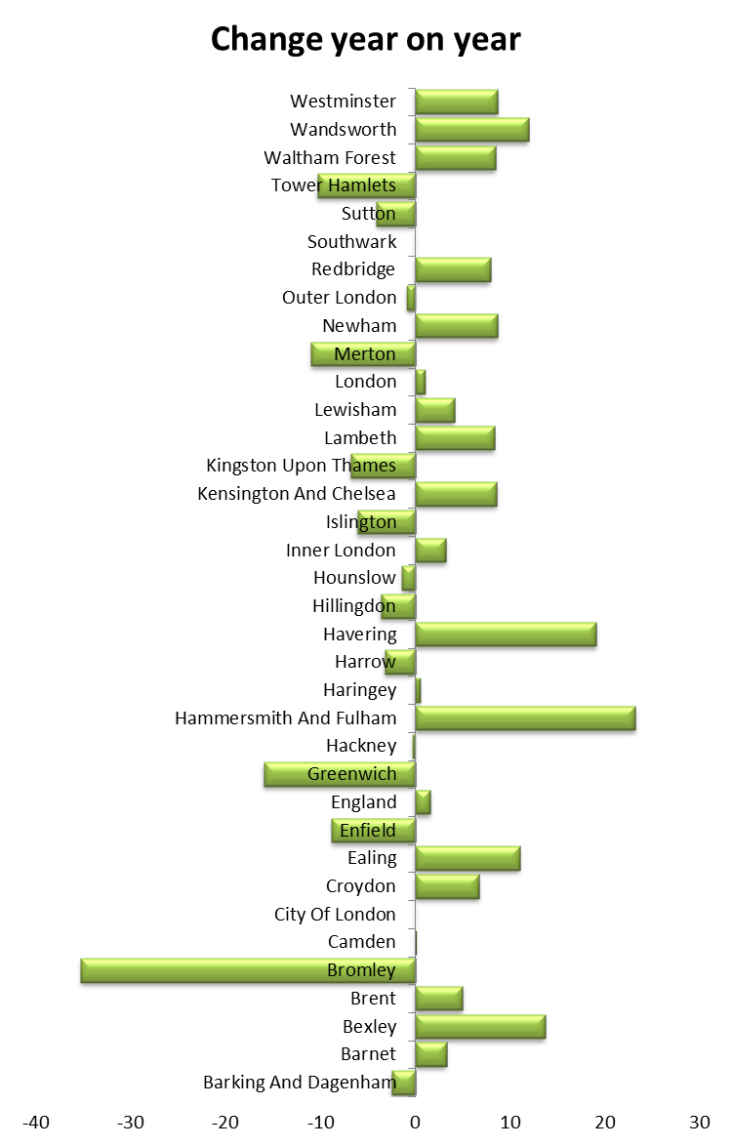
Turnover Rates
The Turnover rate fluctuates across Year on Year. The graph below shows the change in Turnover rate between 2017 and 2018 Across London LA’s
There is less variance in overall Turnover rate for London indicating this is shifting problem across LA’s year on year.

Slide 8
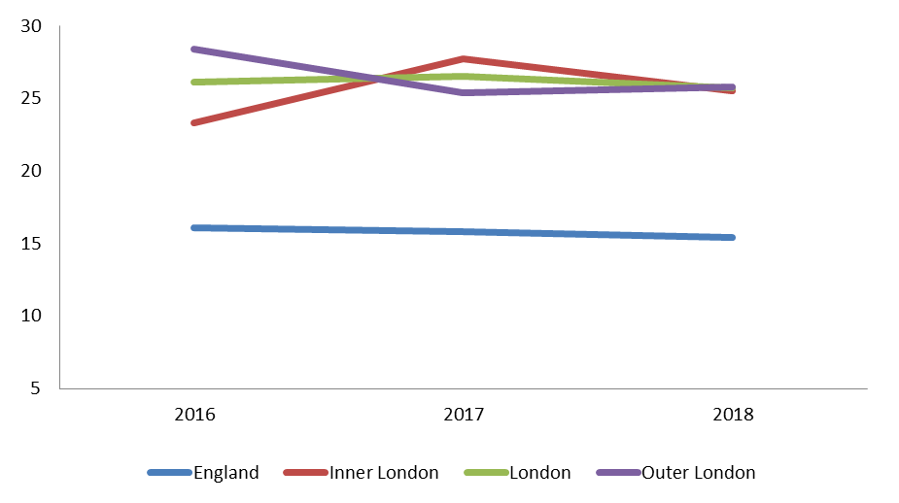
Vacancy Rates
Vacancy Rates 2018
England: 16.5%
London: 25.6%
Inner London: 25.9%
Outer London : 25.3%
England, and Inner London saw a slight increase year on year in Vacancy rates whilst Outer London observed a slight Y-o-Y decrease of -2% points.

Slide 9
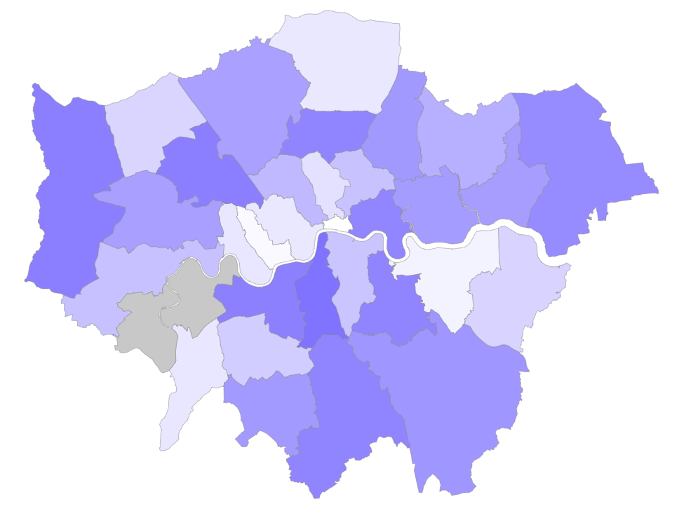
Vacancy Rate 2018
The Vacancy Rates vary considerably across the borough from 40% in Lambeth to 5% in City of London.
As can be seen from the Heatmap there are variations in rate % across London

Slide 10
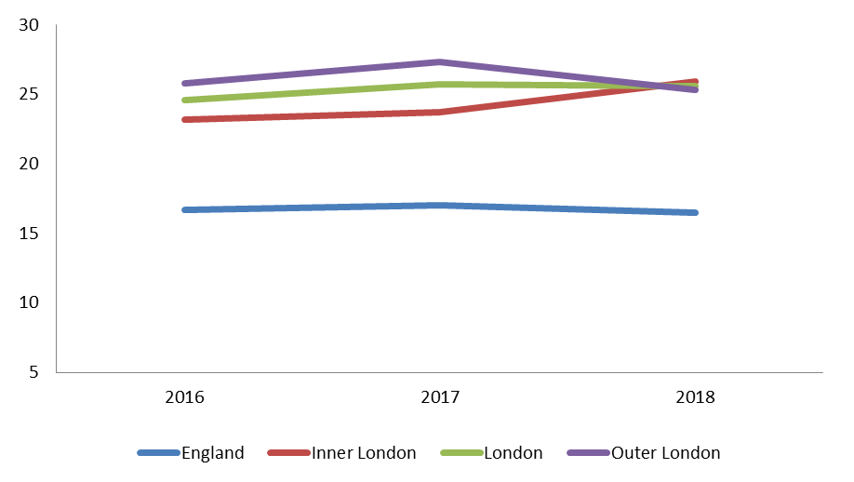
Agency Rates
England: 15.4%
London: 25.7%
Inner London 25.5%
Outer London 25.8%
The England ratio of agency workers is 1 in 6, compared to a London ration of 1 in 4. Inner London saw slight decrease in agency rates year on year.
The 2% gap between Inner and Outer London has narrowed since last year and rates are similar for Inner and Outer London.

Slide 11
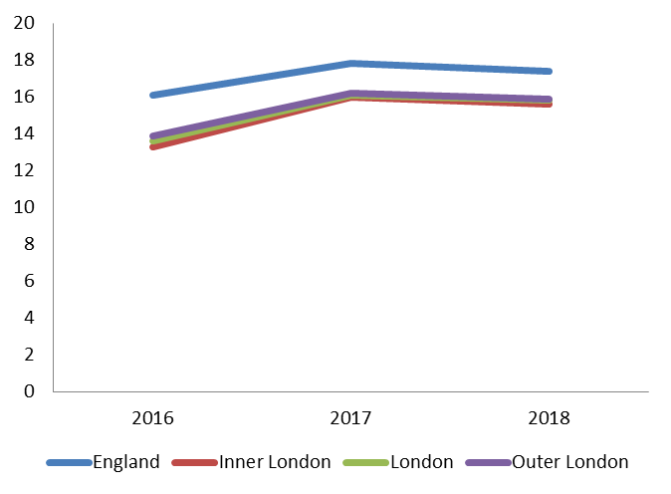
Average caseload
The Average caseload has shown the same data pattern in inner London and Outer London from 2016.
The average caseload has followed the England average in the three year data period.

Slide 12
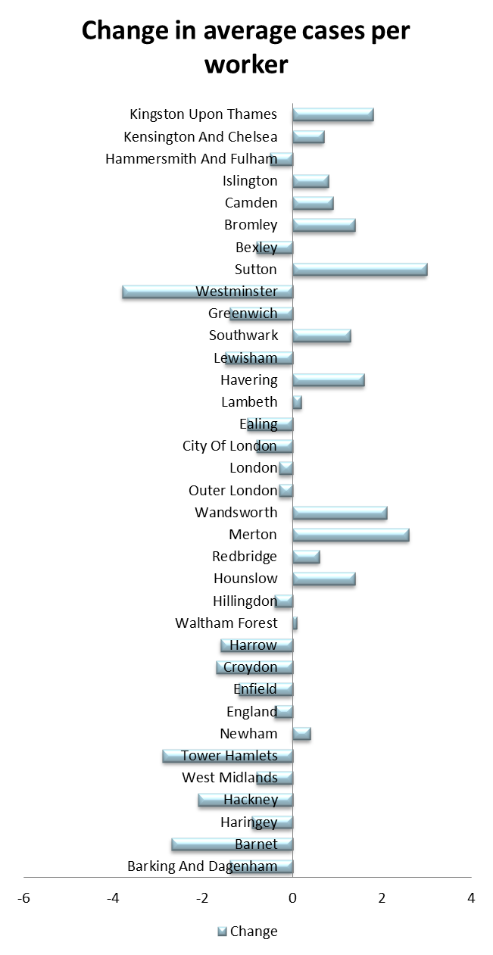
Average caseload
The average number of cases per worker fluctuated from 18.3 in London to 12 in 2018 in different boroughs.
The average cases however changes year on year across boroughs

Slide 13
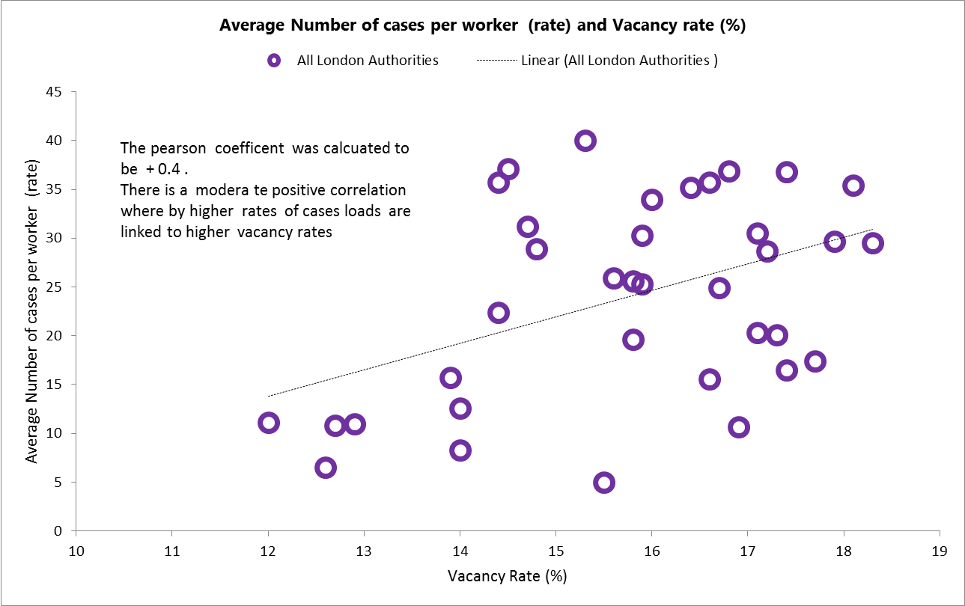
Data Correlations Vacancy and Case Load rates
There is a moderate correlation between average number of cases per worker and vacancy rate.

Slide 14
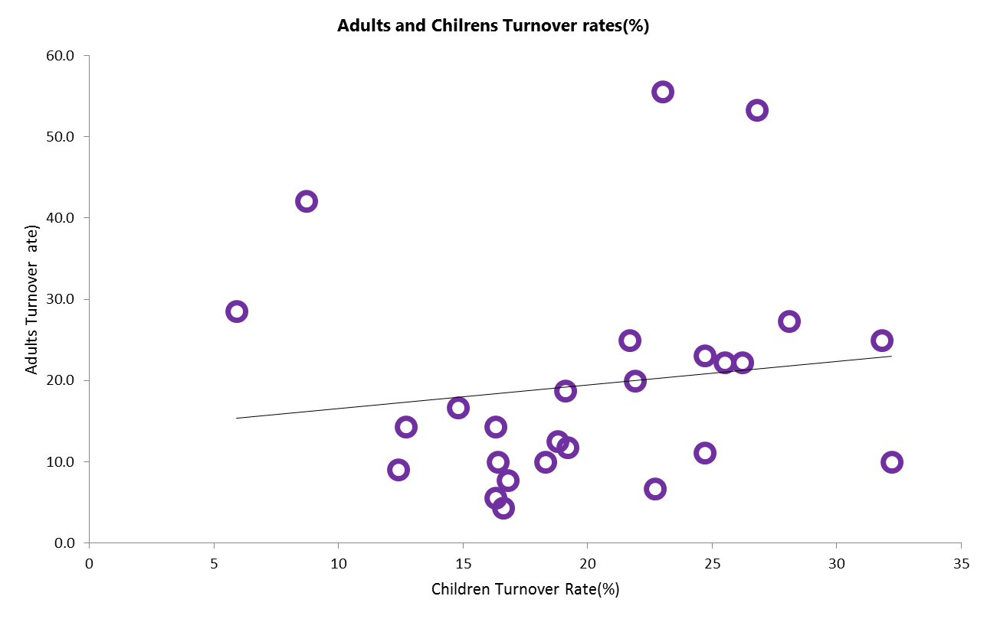
Data Correlations Adult and Children Workers
There is a no noted correlation between Adult turnover and Children workforce turnover rates.
Pearson Correlation calculated to be 0.1

Slide 15
Other Data –HESA/Skills for Care Analysis
Enrolments
Postgraduate enrolments increased by 13% in 2016/17 following a 14% increase in
2015/16. This number had previously decreased each year between 2010/11 and 2014/15.
In 2016/17 undergraduate enrolments decreased by around 350 (12%) on the
previous year. Undergraduate enrolments had remained at broadly the same level between 2012/13 and 2015/16 (at around 3,000 per year).
Qualifiers
Of the 4,560 leavers from social work courses in 2016/17, 4,220 (93%) achieved a
qualification.
The number of qualifiers was 5% higher in 2016/17 compared to the previous year.
This comes after two consecutive periods of decreasing qualifiers.
Given the trend in enrolments; Skills for Care modelling forecasts that the number of leavers will remain broadly the same in 2017/18.

