Slide 1





A London Ventures introduction to ‘tap-it’
  Keeping you safe and connected to the people you trust
28th July 2015

Slide 2
tap-it app and website demonstration
Settings
Setting up network
Collect me
Interrupt me
Locate / Check in
Incident recording / alerting
Safe havens
Follow up / Enhanced follow-up
tap-it website
Council push messaging
Neighbourhood policing intelligence

Slide 3
Common questions
Confused with emergency response?
Tap-it is not an emergency response tool and marketing material makes this clear.
Why not just call / SMS a friend?
Tap-it broadcasts messages and locations to network of friends with a single tap – and it is free of charge.
Effort to implement?
Tap-it has very minimal effort to deploy. The focus needs to be on marketing and promotion through existing channels.
  Standard marketing collateral will be provided for local tailoring.

Slide 4
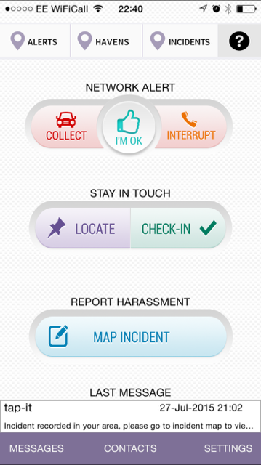

Slide 5
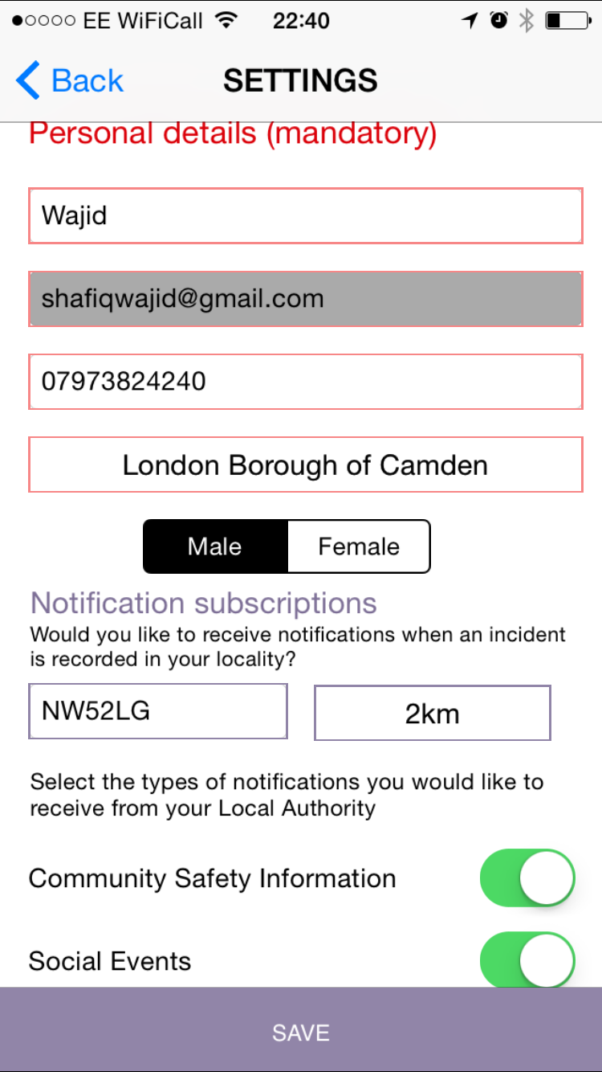

Slide 7
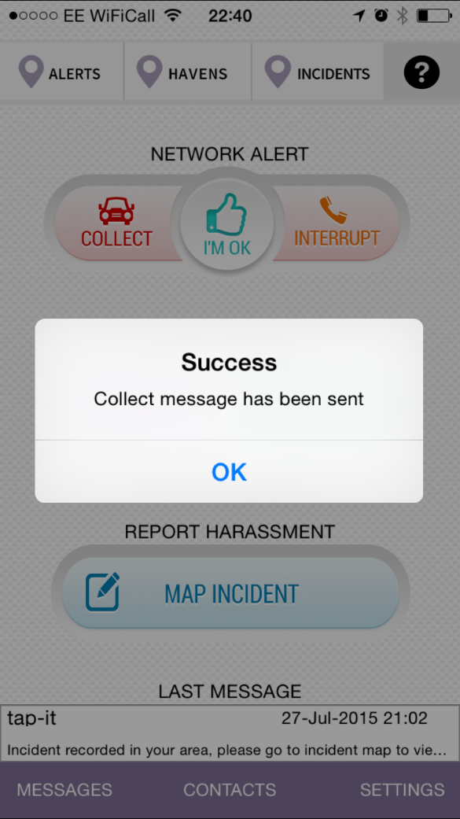
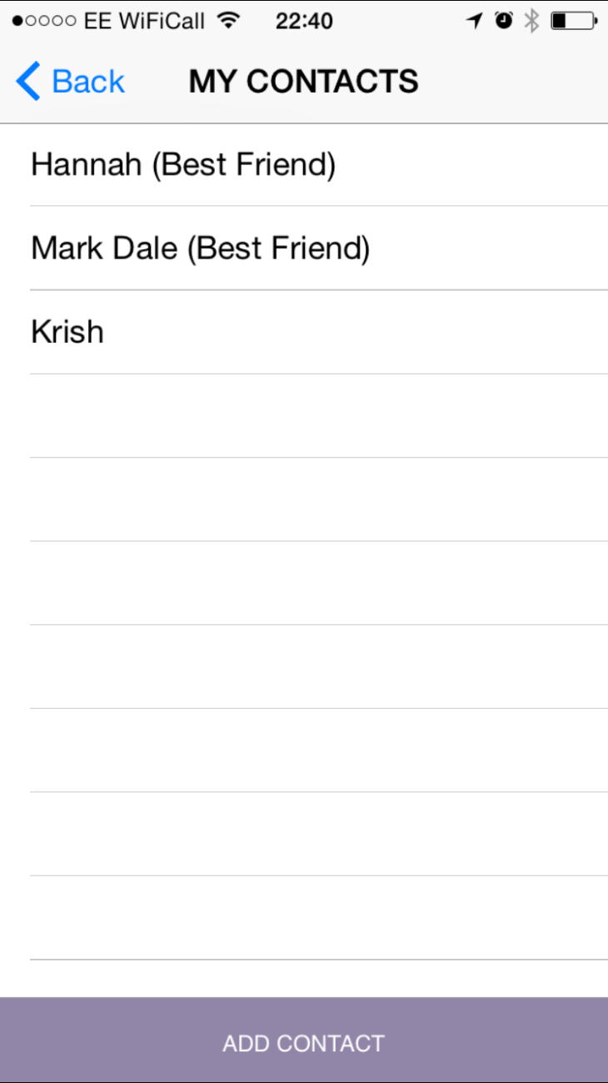

Slide 9
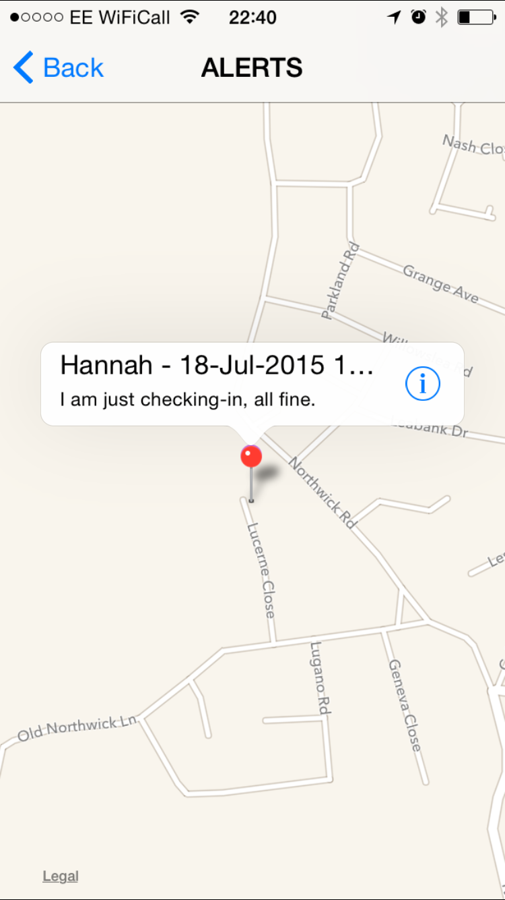

Slide 10
