Slide 1
London Infrastructure Framework
building London’s sustainable, inclusive future

Slide 2
Purpose of the framework
At any given time, a significant number of infrastructure projects are being delivered and developed across London. The purpose of the framework is to identify opportunities for planning and delivery to be done more efficiently, support ambition across projects and programmes, and enable a more united voice supporting strategic projects in accessing funding.
It provides a conceptual framework for setting out the relationship of projects to a set of strategic priorities that embed inclusive and sustainable growth. The priorities are intentionally broad, allowing for flexibility and judgment.
The types of infrastructure covered by the framework align with the NIC classification (service or enabling infrastructure): While housing and social infrastructure are not included in the framework, the priorities also take into account the infrastructure schemes that can unlock wider development.

Slide 3
Project selection criteria
Reaching Net Zero
Embedding sustainability, decarbonisation, and climate resilience
Future-facing
Balancing need to keep pace with demands and requirements, with broader structural changes needed
Housing & Development
Unlocking employment space, social infrastructure, or housing; enabling use of planning consents
London-wide Impact
Potential for multi-borough social and economic impact, often as well as multi-borough scale
Considering Geography
Enhancing the relationship between infrastructure and strategic spatial planning across greater London
Deliverable & Investable
Sufficiently developed as to indicate deliverability, even if funding needs are outstanding

Slide 4
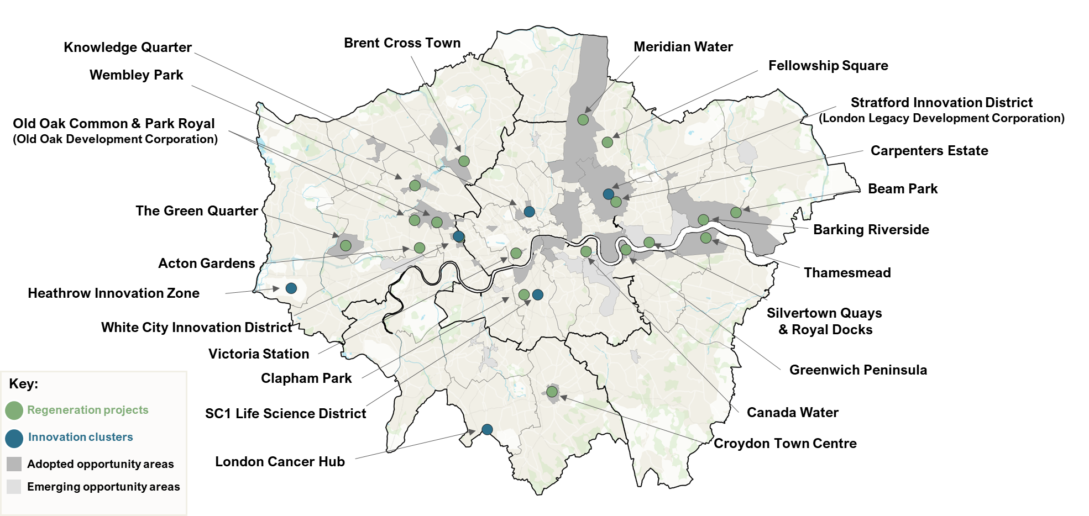
Regeneration and Innovation clusters
Infrastructure has been essential in unlocking development and supporting the evolution of the city. The Mayor’s London Plan identifies a series of Opportunity Areas as key locations for new homes, jobs and infrastructure of all types.

Slide 5
Strategic categories for projects and programmes
The strategic fit criteria were applied to 180 projects and programmes collected from boroughs and sub-regional partnerships. 67 projects were identified as relevant to the infrastructure project through a review process which was not a formal prioritisation and which balanced the various strategic considerations. Those projects were further categorised into the following groups:
Pan London Exemplars: Projects with London-wide significance, typically with both geographic scale and significant potential economic and social impact; performing across multiple strategic criteria.
Sub Regional Exemplars: Projects with noteworthy strategic impact and scale, but typically not so extensive as to extend over more than five boroughs.
Strategic Pilots: Relatively small-scale projects which are pioneering new approaches or employing new technologies to deliver infrastructure and promote sustainability.
Growth Catalysts: Projects with typically smaller scale, but significant potential to unlock more immediate growth opportunities through planned housing, employment space, or social infrastructure.
Potential to create meaningful and positive socio-economic impact
Contributing towards London’s decarbonisation and Net Zero transition

Slide 6
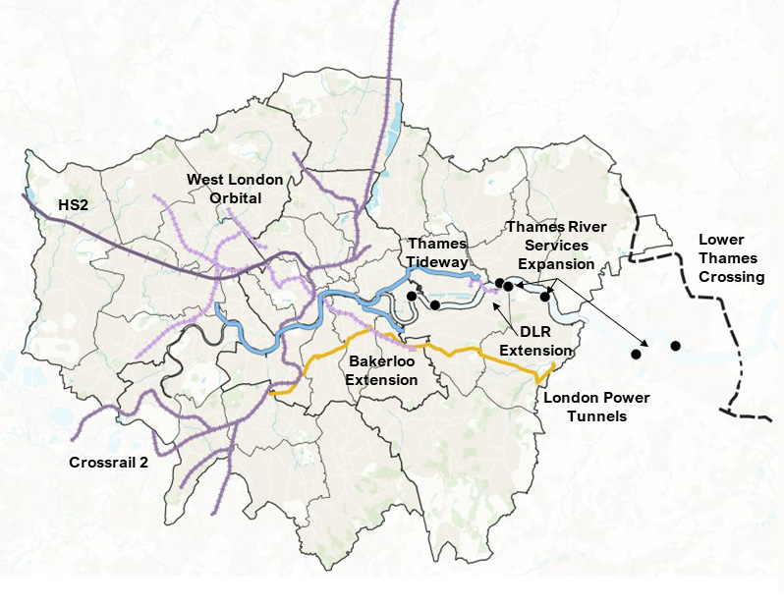
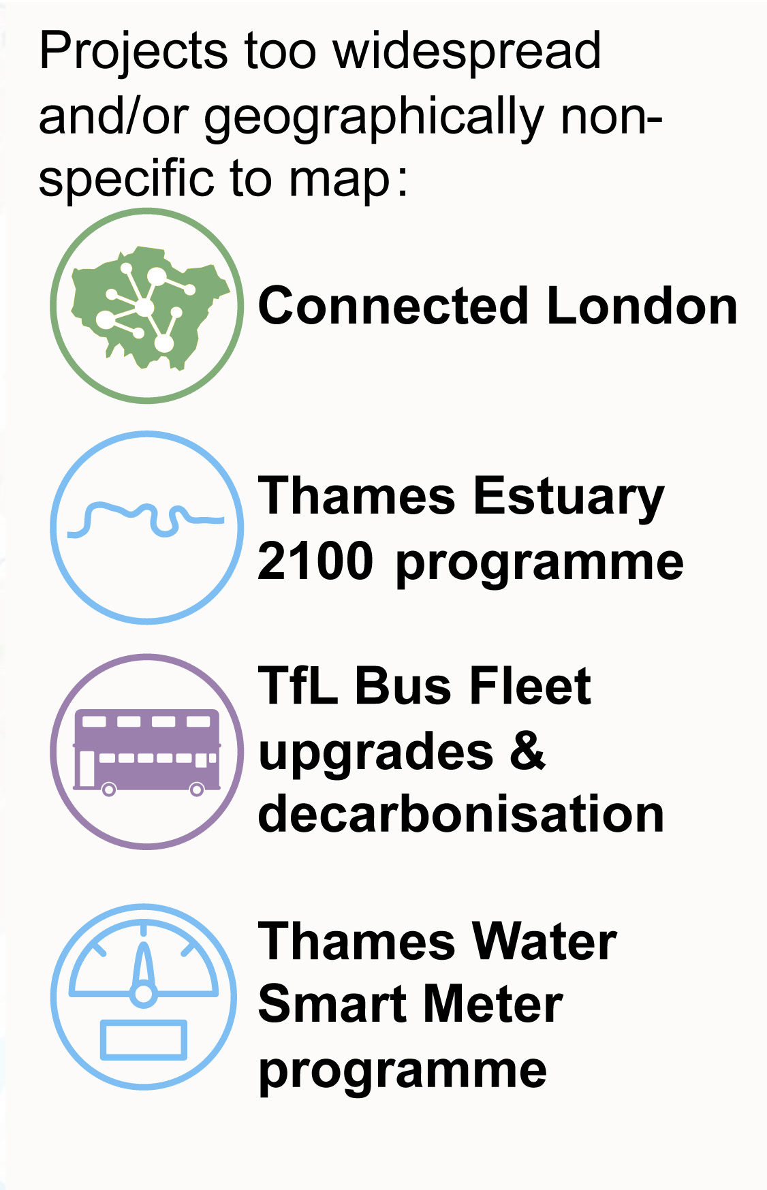
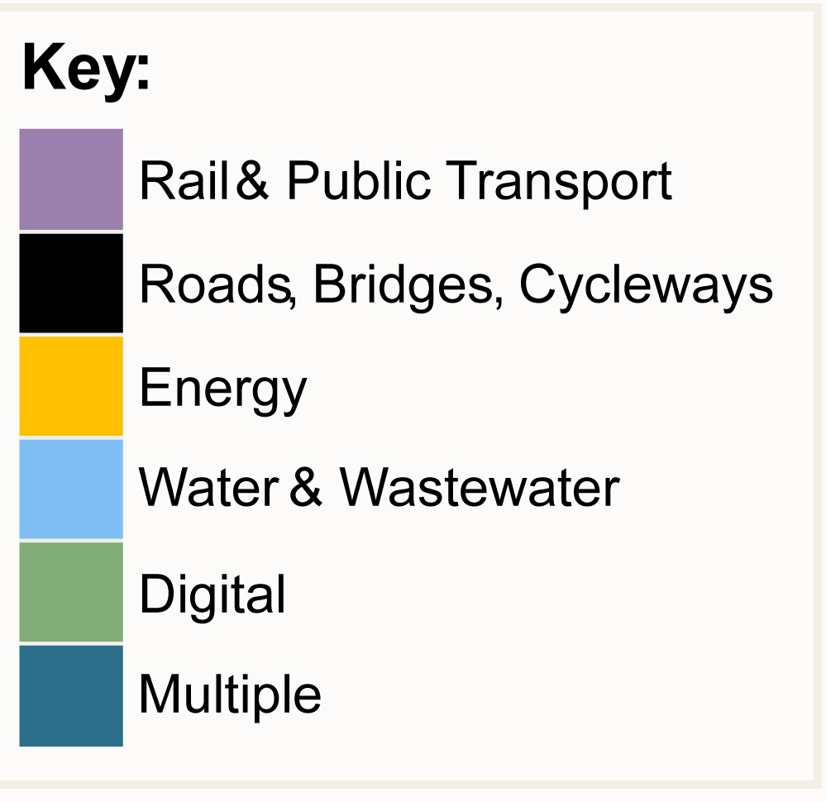
London-wide exemplars

Slide 7
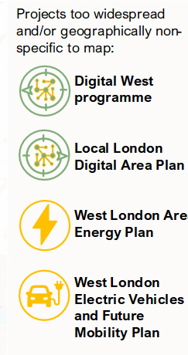
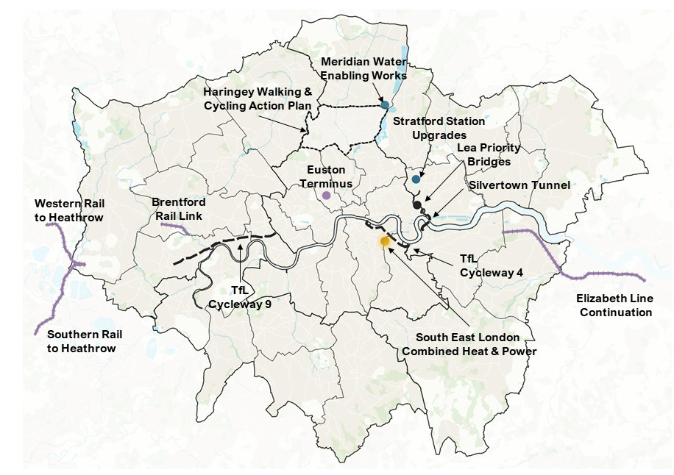
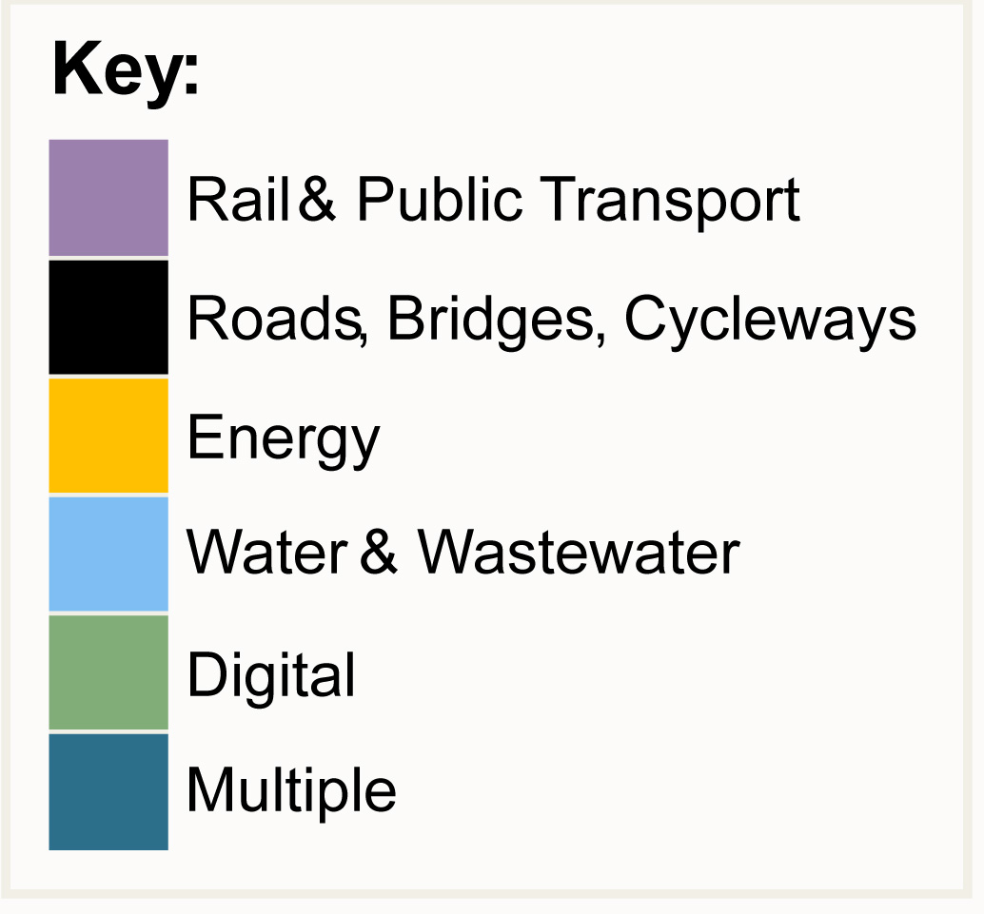
Sub regional exemplars

Slide 8
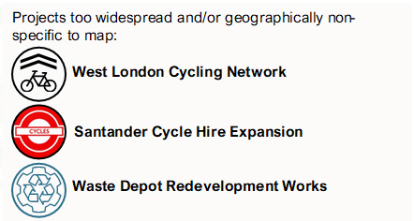
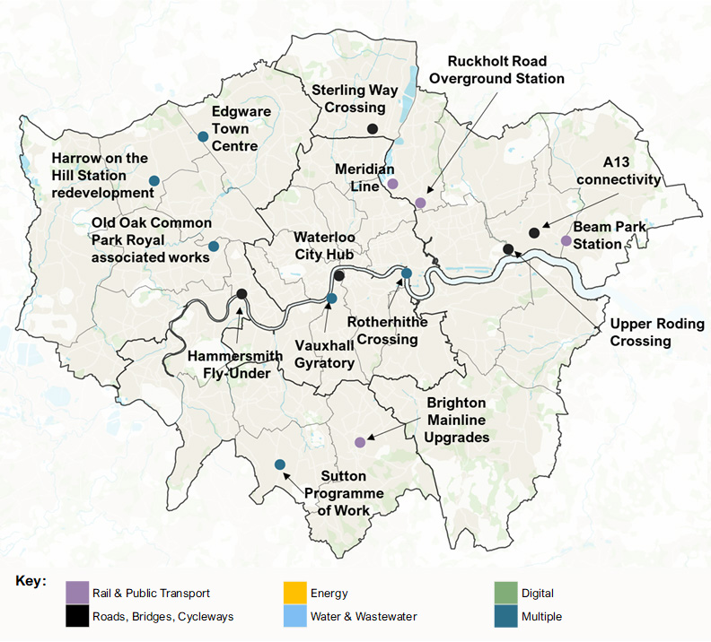
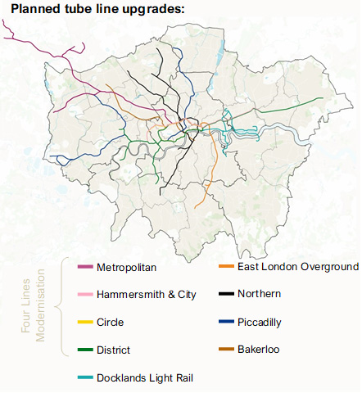
Growth catalysts

Slide 9
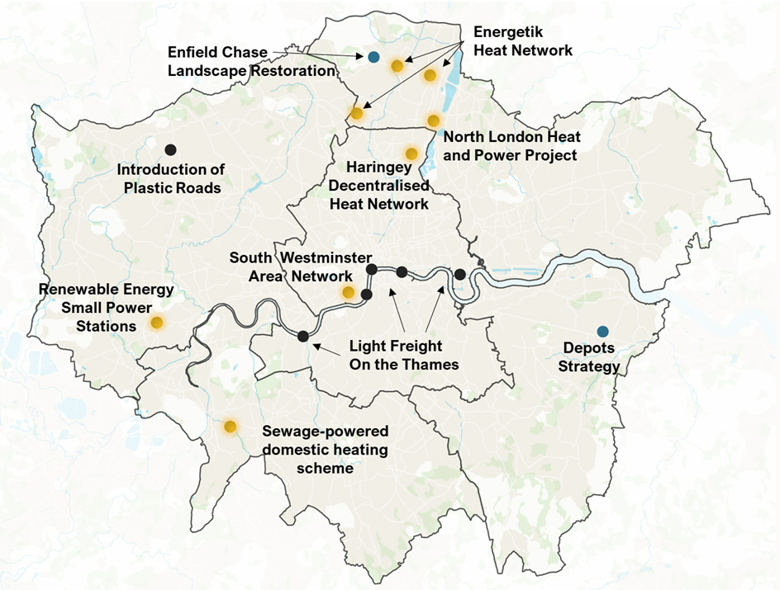
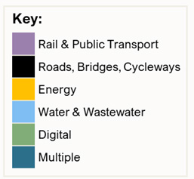
Strategic pilots

Slide 10
Principles for strategic infrastructure development & delivery
A consensus-led approach should enable solutions and interventions that benefit all of London, even if not necessarily at the same points in time.
Pan-London collaboration should support parts of London with less capacity to meet the long-term vision of a thriving and polycentric economic geography.
Shared governance and accountability across London, evolving economic governance so that it continues to lead and co-ordinate impactful investment.
London should become increasingly self-sufficient, with skills and flexibilities to progress strategic priorities even in a constrained public funding environment
Fit-for-purpose solutions should be developed and applied to strategic infrastructure interventions from a practical toolkit of potential supports
Risk should be shared across a number of partners, and borne by the institutions best set up to manage it, rather than a single authority or provider.
Long term strategic public private partnerships should create opportunities to optimise socioeconomic and environmental outcomes over time.

Slide 11
Recommendations
London should develop a new growth, investment and devolution deal proposition with a new gainshare principle based on London generating a higher rate of growth for the UK, in return for being able to retain and invest more of the proceeds of locally driven growth.
London should develop a range of partnership and delivery vehicles to create shared capacity and capabilities around specific infrastructure challenges and opportunities facing London.
London should develop a central infrastructure development and delivery centre of expertise.

